Slide 1
Getting Started with Python
Notes:
This chapter introduces Python. We describe what "Python" actually means, and show how to get started writing simple Python applications.
We'll start off by discussing what Python is and why it's used. Then we'll dive in and show how to install Python and start writing Python programs. As we'll show, Python is an interpreted language with dynamic data typing, which makes it ideal for rapid application development.

Slide 2
Contents
Setting the scene
Downloading and installing Python
Running Python script code
Annex
Creating a virtual environment
Demo folder: 02-GettingStarted
Notes:
Each chapter in this course is divided into several sections. There are three sections in this chapter…
Section 1 sets the scene. We introduce Python as a programming language, describe its capabilities, and discuss some fundamental concepts you need to know before you start writing any code.
Section 2 shows how to download and install Python on various platforms. We'll discuss Python versions, and summarize some of the differences between these versions.
Section 3 describes how to run Python script code, either interactively at the command line or by creating and running Python script files. We'll also show how to use IDLE, a Python IDE that comes pre-installed in Python for Windows.
Note: Each chapter in this course has a dedicated set of demo code and lab code. The demos for this particular chapter are located in the 01-GettingStarted sub-folder. So, if the course code is installed in the standard location, you'll find the demos for this chapter here:
C:\PythonDev\Demos\02-GettingStarted

Slide 3
1. Setting the Scene
Hello Python
What can you do with Python?
About Python Django
Notes:
It's time to get started. This section outlines the principles of Python, so you have a mental context for the details that follow.

Slide 4
Hello Python
Python is powerful, expressive programming language
Object-oriented
Dynamic typing
Interpreted
Available on a wide range of platforms
Unix/Linux
Windows
Mac OS X
etc.
Notes:
Python is a powerful, easy-to-learn, programming language. It has all the high-level structures and flow-control mechanisms you'd expect in a contemporary language.
Python supports object-oriented programming, so you can write classes and use inheritance. Python is interpreted and supports dynamic typing, so it's an ideal language for scripting and rapid application development.
Python is supported on a wide range of platforms, including Unix/Linux, Windows, Mac OS X, etc.
Python programs are typically much more concise than if you used C, C++, or Java. This is thanks to the many shortcuts available in the Python language (e.g. grouping statements together by indentation rather than by {} braces, and the fact you don't need to pre-declare variables or arguments). This might come as a bit of a culture shock initially, but you'll soon come to love it!

Slide 5
What can you do with Python?
Scripting
File I/O
XML processing
String handing and regular expressions
Web applications, using Django
Web services
Notes:
Many people use Python as a better scripting language. It's a lot more powerful (and easier to use) than Unix shell scripts and/or Windows batch files. Python is a "real" programming language, and offers much better language features than scripts and batch files.
Python is highly modular - you can split your program into modules, and then reuse the modules in other Python programs. Python has a lot of standard modules for performing common tasks such as file I/O, XML processing, sockets and networking, etc.
There are also modules available that allow you to implement web applications and web services, so it's a very powerful platform indeed.

Slide 6
About Python Django
Django is a popular web framework
Object-relational mapper
Automatic administrative interface
Customizable URL routing
Widely used by major web sites, including:
Instagram
Mozilla
Lego it
…
Notes:
Django is built on Python, and enables you to create data-backed web sites quickly and easily. It's an open and free set of APIs and tools that enable you to create an object model for a database, and create an administrative user interface to manage the data (create records, update records, etc.).
Many popular web sites use Django. For a full list, see http://www.djangosites.org/.

Slide 7
2. Installing and Using Python
Downloading Python
Installing Python
Using Python Documentation
Python versions
Installing Python packages
Notes:
This section describes how to download and install Python SE on various platforms. We'll also introduce you to Python documentation, and talk a little about the different versions of Python available.

Slide 8
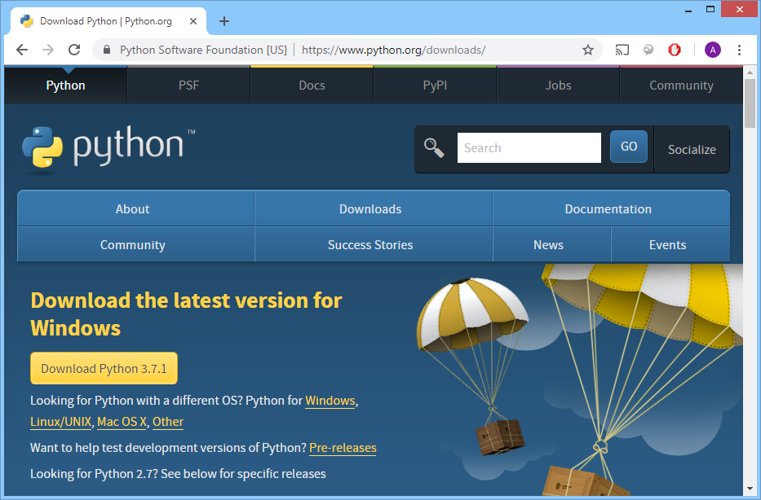
Downloading Python
You can download Python for free
https://www.python.org/downloads/
Notes:
You can download Python for free from https://www.python.org/downloads/. The screenshot in the slide shows the download page - the version might be slightly different for you.
The computers on this course use Windows, and we've already installed Python for Windows. You can also download Python for other platforms, via these URLs:
For Linux/Unix: https://www.python.org/downloads/source/
For Mac OS X: https://www.python.org/downloads/mac-osx/
For other platforms (e.g. AS/400, Solaris, HP-UX): https://www.python.org/download/other/
Note: Python comes preinstalled on most Linux distributions. However there are certain features you might want to use that are not available on your distribution’s package. You can easily compile the latest version of Python from source. Here are some lines you might find helpful:
For Debian users: http://www.debian.org/doc/manuals/maint-guide/first.en.html
For OpenSuse users http://en.opensuse.org/Portal:Packaging
For Fedora users: http://docs.fedoraproject.org/en-US/Fedora_Draft_Documentation/0.1/html/ RPM_Guide/ch-creating-rpms.html

Slide 9
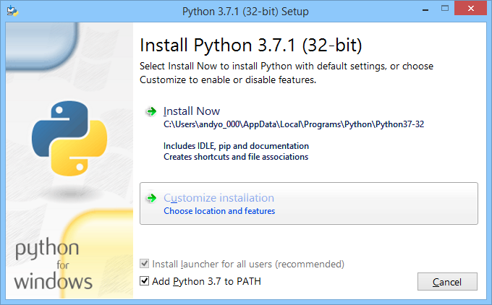
Installing Python (1 of 3)
Notes:
After you've downloaded the Python installation program, run it to commence installation. The first screen in the installation program is shown in the slide above. Note the following points:
Select the option to Add Python 3.7 to PATH.
Then click the Customize Installation option. This allows you to specify the installation location, and also to choose which optional features you want to install. See the next slide for details.

Slide 10
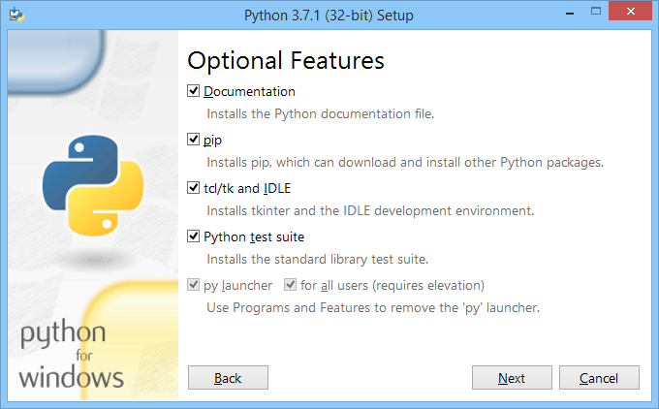
Installing Python (2 of 3)
Notes:
The screenshot above shows the optional features that you can choose to install. By default, all features are selected. We recommend you keep it that way.
Here's a brief description of each feature:
Documentation Installs documentation in the Doc sub-folder. The documentation is a .chm file, i.e. a standard Windows compiled help module.
pip Installs pip, the standard Python Installer Program that allows you to install binary libraries into your Python platform. As of Python 3.4, pip is included in the standard Python platform.
Tcl/tk and IDLE Installs Tkinter and IDLE (a simple Python IDE for Windows).
Python test suite Installs the test suite into the Lib/test/ sub-folder.
py launcher Installs the global launcher for .py files, to make it easier to run Python scripts wherever they are located on your system.
After you've digested these details, click Next to continue.

Slide 11
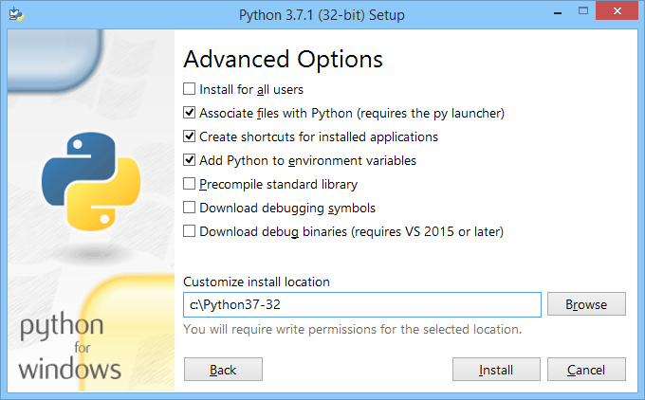
Installing Python (3 of 3)
Notes:
The screenshot above shows the advanced options that you can select. You might like to enable the option to install for all users. You might also want to change the installation location, to make it a bit easier for you to find Python on your system.
When you're ready, click Install.

Slide 12
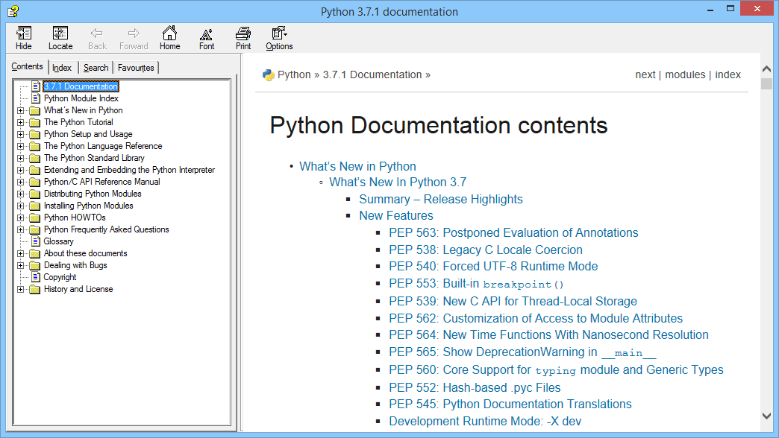
Using Python Documentation
Notes:
The supplied documentation is pretty good actually, certainly as a starting point if you're new to Python. In Windows, the documentation file is located in the Doc sub-folder beneath your Python installation location, and the filename is python371.chm.
You can also get Python documentation online at https://docs.python.org.

Slide 13
Python Versions
Major differences between Python 3.x and Python 2.x
print() is a function, not a statement
Collection classes have changed
Integer data type names have changed
Binary data and Unicode text has changed
Several new/modified keywords
For example, this is how print() has changed:
print "Two plus two is", 2+2
Python 2
print("Two plus two is", 2+2)
Python 3
Notes:
If you've come from Java or C++, where languages tend to evolve in a consistent and non-breaking kind of way, you'll probably be surprised (and alarmed) to learn that there are significant inconsistencies between different versions of Python.
There are quite a few important differences between Python 3.x and Python 2.x, some of which are listed on the slide above. In practice, this means Python 2.x code won't work on a Python 3.x platform - you'll get a lot of syntax errors.
For more information about the differences between Python 3.x and Python 2.x, see http://docs.python.org/3/whatsnew/3.0.html.
You can also use the __future__ statement to help you write compatible code between Python versions 2.* and 3.*. For more details about __future__, see https://docs.python.org/2/library/__future__.html
As a general rule of thumb, you should try to drop support for Python 2.5 and earlier, because Python 2.6 introduces quite a lot of forwards compatibility.

Slide 14
Installing Python Packages
There are many Python packages available
E.g. NumPy, MatPlotLib, etc.
See https://pypi.python.org/pypi for details
You can use the pip package manager to install Python packages
For example, to install the MatPlotLib package:
To find where pip installed a package:
pip install matplotlib
pip show matplotlib
Notes:
Python is an open-source development project, and there is an active community of contributors who make their software available as 3rd-party packages for other Python developers to use.
For example, here are some popular Python packages that we'll discuss later in the course:
NumPy - scientific computing
MatPlotLib - plotting library
If you want to use such packages in your code, you can download them using the pip command-line tool. For example, to install the MatPlotLib package, run the following command:
pip install matplotlib

Slide 15
3. Running Python Script
Running Python script interactively
Creating variables
Line continuation
Blocks
Customizing Python
Creating and running Python modules
Aside: Python keywords
Porting Python 2 code to Python 3
Using IDLE
Notes:
This section describes how to write and run Python script code, either interactively at the command prompt or by executing modules (a module is just a file that contains Python script code).
We'll also introduce IDLE, a Python IDE that comes as a standard part of Python for Windows.

Slide 16
Running Python Script Interactively (1 of 2)
First, ensure Python is on the path
Then run the Python interpreter in interactive mode, and execute Python code
set path=C:\python37-32;%path%
python
print("Hello Python!!!")
Notes:
Python is an interpreted language. You can run Python script code directly through the Python interpreter, as shown in the slide.
You need to ensure Python is on the path. To do this in Windows, type the following command in the command window:
set path=C:\python37-32;%path%
If you're using Unix/Linux, put /usr/local/bin in your Unix shell's search path.
See the following slide for an example.

Slide 17
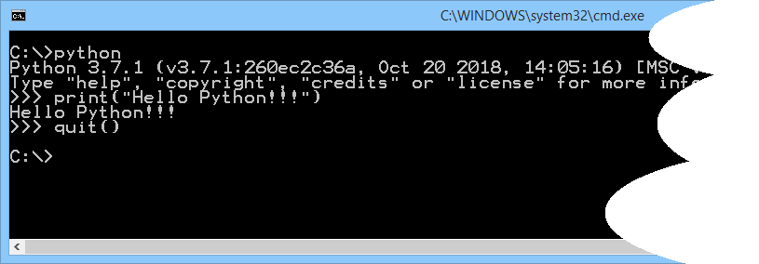
Running Python Script Interactively (2 of 2)
Example
Notes:
This slide shows an example of running Python script interactively.
When you run the Python interpreter as shown in the slide, it runs in interactive mode. In this mode, it prompts you for the next command with the primary prompt, i.e. >>>. This allows you to execute statements line-by-line, such as the print() function as shown in the example. To exit interactive mode, call the quit() function or type an end-of-file character (Ctrl+Z in Windows, Ctrl+D in Unix/Linux).

Slide 18
Creating Variables
In Python, you don't need to declare a variable
Just assign it a value, and Python will create it for you dynamically
Rules for identifiers in Python
Can contain uppercase or lowercase letters, digits, and underscore
But can't start with a digit
firstname = "Homer"
lastname = "Simpson"
fullname = firstname + " " + lastname
print(fullname)
Notes:
Note that we don't specify the type of a variable in Python. The Python interpreter uses dynamic typing, i.e. variables are assigned values at run time, and it's only then that the Python interpreter knows what the data type is.
Note the following points about the example in the slide:
First. we create a variable named firstname and assign it the value "Homer".
Next, we create a variable named lastname and assign it the value "Simpson".
Then we create a variable named fullname and assign it the full name, "Homer Simpson".
Finally we call print(), a standard Python function to print a message on the console.

Slide 19
Line Continuation
If a statement spans multiple lines…
You can use \ to continue from one line to the next
firstname = "Homer"
lastname = "Simpson"
fullname = firstname + \
" " + \
lastname
print(fullname)
Notes:
The backslash character \ is the line continuation character in Python. It allows you to execute statements that span multiple lines. Note that expressions in parentheses, square brackets, or curly braces can be split over more than one physical line without using backslashes.
The example in the slide shows how to use the \ character - see the statement where we build up the fullname variable.

Slide 20
Blocks
Python uses indentation to denote blocks
Don't use {}
Use : to indicate the start of an indented block
age = 21
if age >= 18 and age <= 30:
print("You are eligible for an 18-30s holiday!")
Notes:
Blocks are important in any programming language. For example, they enable you to create multi-statement bodies for if-tests, while-loops, etc.
Unlike most programming languages, Python doesn't using anything like braces {} to denote the start and end of a block. Instead, Python relies on indentation. To indicate which statements are inside a block, you simply indent the statements by the same amount of spaces.
Note the following points about the example in the slide:
First, we create a variable named age and assign it the value 21.
Then we have an if statement to test if age is between 18 and 30 inclusive. Note there's no need for parentheses around the test. Also note the :, which indicates the start of an indented block.
Next we call print(), to print a message indicating the person is eligible to go on an 18-30s holiday (if they really want to!). Note that this statement is indented, which is significant.
After the print() function is an empty line. There's no indentation here, which indicates the end of the if statement block, so the Python interpreter executes the code and outputs the message.

Slide 21
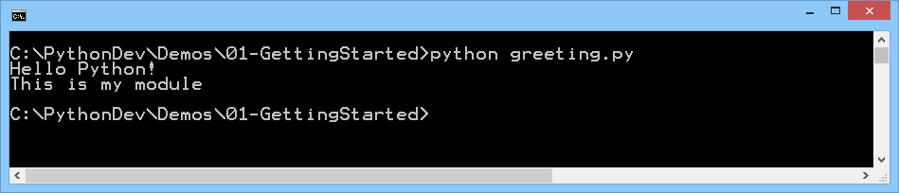
Creating and Running Python Modules
You can put Python code into modules
A module is just a script file containing Python code
Typically starts with a lowercase letter, and ends in .py
You can run the module via the Python interpreter
print("Hello Python!")
print("This is my module")
greeting.py
python greeting.py
Notes:
Whilst it's handy to be able to execute Python code interactively at the Python prompt, you'll probably spend most of your time writing Python code in script files.
Python uses the term "module" to mean a script file. Modules are usually lowercase, and have the .py or .pyc file extension. The upper code box in the slide shows a simple example.
To run a Python script file via the interpreter, simply run Python and give it the name of your module as shown below. The Python interpreter fires up, executes your module, and then terminates.
python greeting.py
On Windows systems, the Python installer automatically associates .py files with the Python interpreter. So you can just double-click on a .py file, and it will automatically be executed as a Python module.
On BSD’ish Unix systems, Python modules can be made directly executable, like shell scripts. To do this, add the following line at the beginning of the module:
#! /usr/bin/env python3.7
Note that the #! characters must be the first two characters of the file. Also, the Python interpreter is on the user's path. You must also give your module an executable mode, which you can achieve by running the chmod command in the shell as follows:
chmod +x greeting.py

Slide 22
Aside: Python Keywords
Here is a full list of all the keywords in Python 3.7
False, None, True
if, elif, else, assert, is
and, or, not
for, in, from, while, break, continue, pass
def, return, global, nonlocal, lambda
import, from
class, del
raise, try, except, as, finally
with, as
yield
await, async
You can ask Python to tell you about all its keywords:
import keyword
keyword.kwlist
Notes:
When you start using a language, it's always a good idea to know what keywords are predefined in the rules of the language. This slide lists all the keywords in Python 3.7.
You can actually ask Python for a list of all the keywords it recognizes, as shown in the script snippet in the slide. Note the following points:
Python organizes its libraries into modules. There's a standard Python module named keyword. This is actually a Python script file named keyword.py, located in the Lib folder.
The keyword module has a kwlist variable, which returns a list of all the keywords recognized by the Python interpreter. This is the result we get back in Python 3.7:

Slide 23
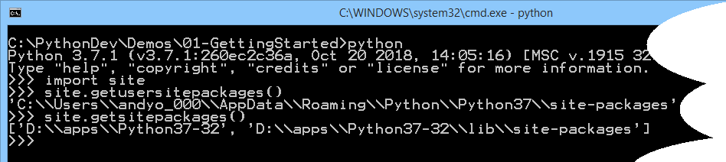
Customizing Python
You can create start-up scripts for Python :
Per-user start-up script: usercustomize.py
Per-side start-up script: sitecustomize.py
To determine where to put these files, run this script:
import site
site.getusersitepackages()
site.getsitepackages()
Notes:
You can customize the way Python works by providing customization scripts, either per-user or per-site. You have to put these scripts into the user-site-packages folder and the site-packages folders respectively. To find out where these folders are, start Python and run the following code:
import site
site.getusersitepackages()
site.getsitepackages()
In this code, the first statement imports the site module. This is a standard Python module, and it defines many functions such as getusersitepackages() and getsitepackages().
The screenshot in the slide what happens when we did this on a Windows machine. If you run the command in Unix/Linux, you might get folders such as the following:
/home/user/.local/lib/python3.7/site-packages
/usr/local/bin/python3.7/site-packages
Once you know which folders to use, you can put customization scripts in those folders. For example, to create a per-user customization script, create a module file named usercustomize.py or sitecustomize.py and put it in the appropriate folder. This script will be executed automatically when Python is fired up.

Slide 24
Porting Python 2 Code to Python 3
Consider the following Python 2 code
Causes errors if you run it via a Python 3 interpreter
You can convert Python 2 code to Python 3 syntax
Use 2to3.py, located in Tools/scripts folder
Specify the -w command-line option
print "Hello Python!"
print "This is my Python 2.x code"
greeting2.py
python C:\Python37-32\Tools\scripts\2to3.py -w greeting2.py
Notes:
Python provides a conversion script that allows you to convert Python 2.x code into new Python 3.x syntax. Consider our example, greeting2.py, shown in the slide. If you run this via a Python 3 interpreter, you get error messages as follows:
To convert Python 2 code to Python 3 syntax, run the 2to3.py Python script (located in the Tools/scripts folder). If you specify the -w command-line option, it overwrites the existing file with the new syntax (it also creates a backup of the original file).

Slide 25
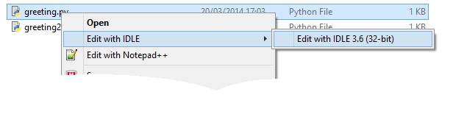
Using IDLE (1 of 2)
IDLE is a free IDE for Python
Included as a standard part of Python for Windows
Right-click a .py file and open it in IDLE
Notes:
IDLE is a free IDE for Python, included as part of Python for Windows. To open a Python file in IDLE, right-click the file and select Edit with IDLE from the popup menu.
Note: Lots of other IDEs are available, including:
PyDev for Eclipse (see http://pydev.org)
Komodo Edit (see http://komodoide.com)
Notepad++ (see http://notepad-plus-plus.org)
IronPython for Visual Studio (see http://ironpython.codeplex.com)

Slide 26
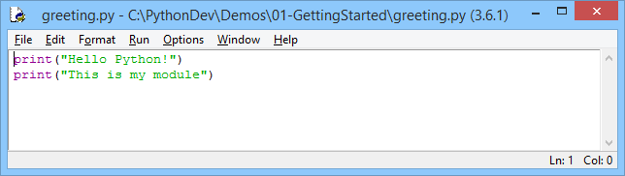
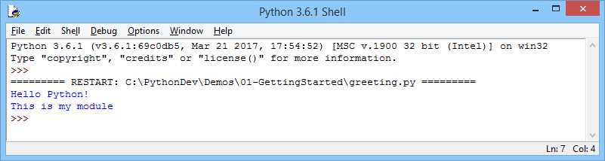
Using IDLE (2 of 2)
IDLE gives you colour coding, IntelliSense, etc.
You can execute the script in a shell, via F5
Notes:
IDLE includes some handy features. For example, the Format menu command lets you comment/uncomment code, indent/unindent code, etc. The Run menu command lets you run the current module (also via F5), and to open a Python shell window.

Slide 27
Any Questions?

Slide 28
Annex: Creating a Virtual Environment
Overview
Installing virtualenv
Creating a virtual environment for a project
Activating a virtual environment
Using virtualenv
Deactivating a virtual environment

Slide 29
Overview
In your life as a Python developer, you'll likely create many applications that use diverse Python packages
Ideally you would like the applications to be independent of each other
The Python packages you download for one application shouldn't interfere with the Python packages for other applications
To help you keep Python application environments isolated from each other, you can use the virtualenv tool

Slide 30
Installing virtualenv
You install virtualenv via pip as a one-off exercise, as follows:
You can test your installation as follows:
pip install virtualenv
virtualenv --version

Slide 31
Creating a Virtual Environment for a Project
To create a virtual environment for a particular project:
This command creates a folder named MyProject that contains:
Python executable files
A copy of the pip library, which you can use to install other packages (locally for this virtual environment)
virtualenv MyProject

Slide 32
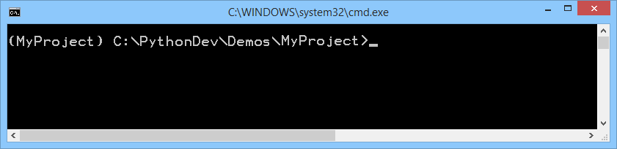
Activating a Virtual Environment
To begin using a virtual environment, you must activate it
After you've activated a virtual environment, its name will appear in the command prompt
E.g. in Windows:
In Unix:
In Windows:
source MyProject/bin/activate
MyProject\Scripts\activate

Slide 33
Using a Virtual Environment
You can now use pip to install packages into your virtual environment
E.g. to install the "requests" package:
Installs the package into the Lib\site-packages folder
You can write a Python script that uses the package
Run the Python script as normal
pip install requests
import requests
response = requests.get('https://httpbin.org/ip')
print('Your IP is {0}'.format(response.json()['origin']))
main.py
python main.py

Slide 34
Deactivating a Virtual Environment
You can deactivate a virtual environment as follows:
This tears down your virtual environment
You don't see the packages in that virtual environment any more
You can reactivate it whenever you need to (see 2 slides previous)
deactivate

